Slide 2
Procedural vs OOP
Procedural programming: writing programs made of functions that perform specific tasks
  Procedures typically operate on data items that are separate from the procedures
  Data items commonly passed from one procedure to another
  Focus: to create procedures that operate on the program’s data
Object-oriented programming: focused on creating objects
Object: entity that contains data and procedures
  Data is known as data attributes and procedures are known as methods
  Methods perform operations on the data attributes
  Encapsulation: a self contained unit combining data and code into a single object

Slide 3
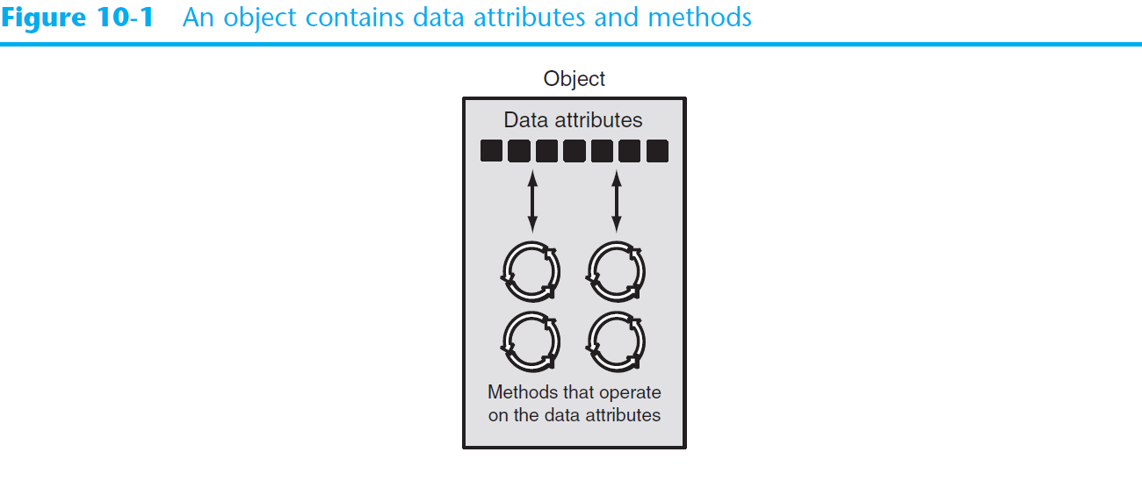
Object-Oriented Programming

Slide 4
Object-Oriented Programming
Data hiding (making private): object’s data attributes are hidden from code outside the object
  Access restricted to the object’s methods
    Protects from accidental corruption
    Outside code does not need to know internal structure of the object
Object reusability: the same object can be used in different programs
  Example: 3D image object can be used for architecture and game programming

Slide 5
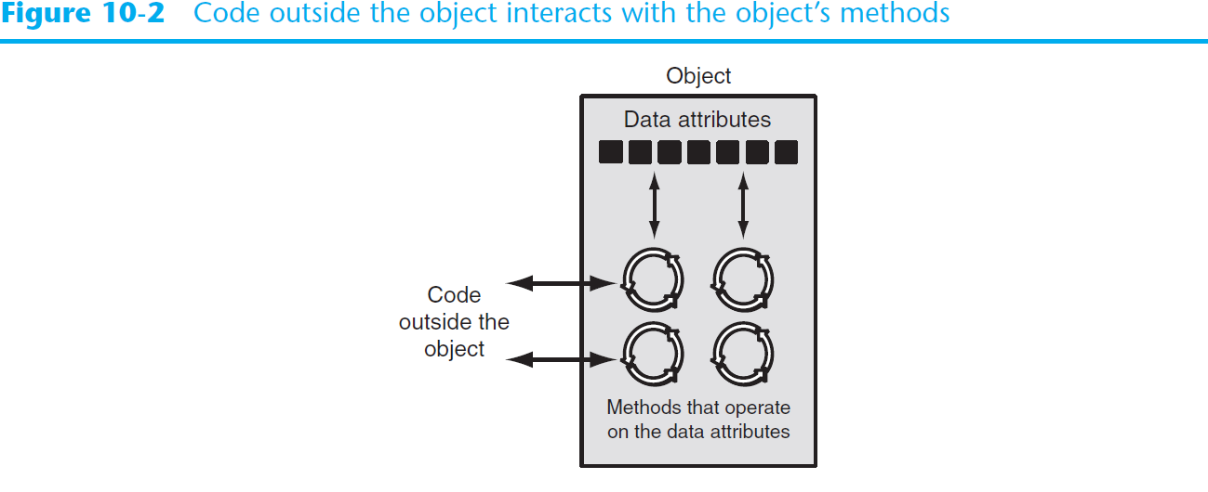
Object-Oriented Programming

Slide 6
An Everyday Example of an Object – Alarm Clock
Data Attributes (private)–
  current_second (a value in the range of 0–59)
  current_minute (a value in the range of 0–59)
  current_hour (a value in the range of 1–12)
  alarm_time (a valid hour and minute)
  alarm_is_set (True or False)
Methods (public)
  set_time
  set_alarm_time
  set_alarm_on
  set_alarm_off
Methods (private)
  increment_current_second
  increment_current_minute
  increment_current_hour
  sound_alarm

Slide 7
Classes
Class: code that specifies the data attributes and methods of a particular type of object
  Similar to a blueprint of a house or a cookie cutter
Instance: an object created from a class
  Similar to a specific house built according to the blueprint
  There can be many instances of one class

Slide 8
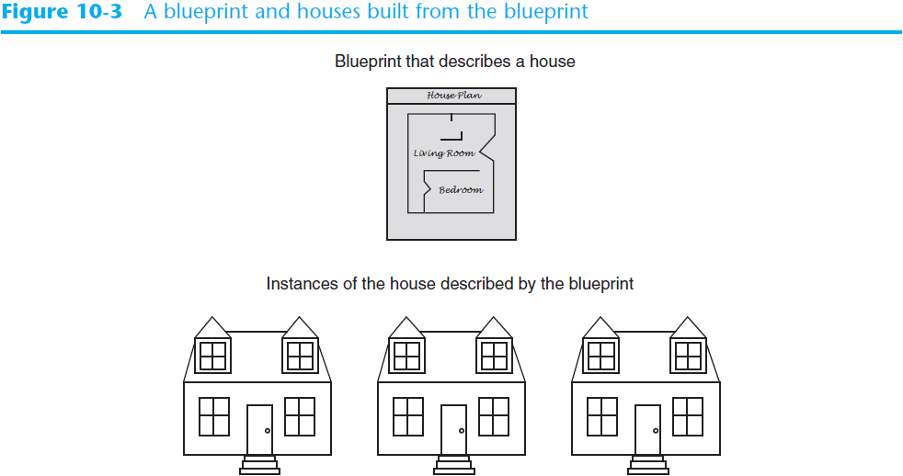
Classes (cont’d.)

Slide 9
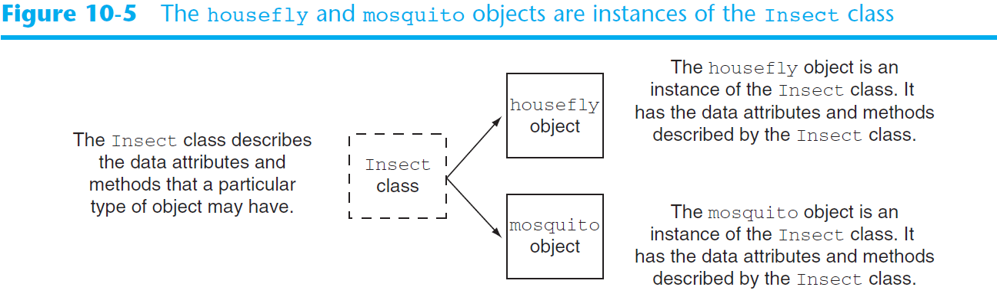
Classes (cont’d.)

Slide 10
Class Definitions
Class definition: set of statements that define a class’s methods and data attributes
  Format: begin with class Class_name:
    Class names often start with uppercase letter
  Method definition like any other python function definition
    self parameter: required in every method in the class – references the specific object that the method is working on

Slide 11
Class Definitions - Example
Coin Toss Example –
  see Coin Toss.py

Slide 12
Exercise
Create a class for an insect object. It should have 2 attributes – wings and legs. For now, the insect object has 2 wings and 4 legs. It should also have 1 method – to determine the length of flight. Length of flight should be a method that randomly assigns a number between 1 and 10 miles. Create a python program that will create an instance of the insect class and print out how many miles the insect can fly.
Create a student class. The class should have 4 attributes. StudentID, Name, DOB and classification (F,S,Jr,Sr).
  Create a method that will calculate the student’s current age and display it on the screen.
  Create a method that will tell the user when the student can register –
    Seniors – 11/1 thru 11/3
    Juniors – 11/4 thru 11/6
    Sophomores – 11/7 thru 11/9
    Freshmen – 11/10 thru 11/12

Slide 13
Exercise
Design a class that represents a cell phone. The data that should be kept as attributes in the class are as follows:
The name of the phone’s manufacturer will be assigned to the __manufact attribute. The phone’s model number will be assigned to the __model attribute. The phone’s retail price will be assigned to the __retail_price attribute. The class will also have the following methods:
An __init__ method that accepts arguments for the manufacturer, model number, and retail price.
set_manufact, set_model and set_retail_price methods that accepts an argument for the manufacturer, model and retail_price respectively and can update it if neccessary.
get_manufact, get_model, get_retail_price method that returns the phone’s manufacturer, model and price respectively.

